Slide 1

Taking a Trip to Charlotte, NC By: Adam Herrman, Jan 2021 IBM Data Science Capstone

Slide 2
The Problem: Visiting Charlotte
How to find the hottest part of town?
How to know which restaurants are best?
How to know which restaurants sever the food we want?
How to find those restaurants?

Slide 3
The Data:
Geopy - the geographical coordinates of Charlotte NC.
The geographical coordinates of restaurants and shopping in Charlotte NC. This will be returned by a Foursquare API “explore” query.
The details, such as, likes, rating, and categories of venues within regions of Charlotte NC. This will be returned by Foursquare API “details” queries for each venue.

Slide 4
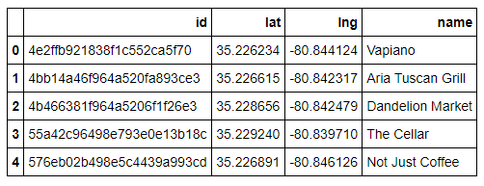
Using Foursqare to find venues
https://api.foursquare.com/v2/venues/explore?&client_id={}&client_secret={}&v={}&ll={},{}&radius={}&limit={}&price={}

Slide 5
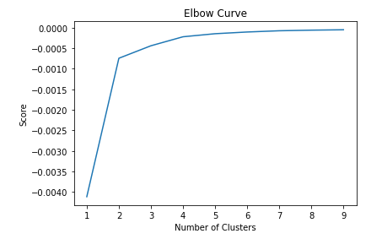
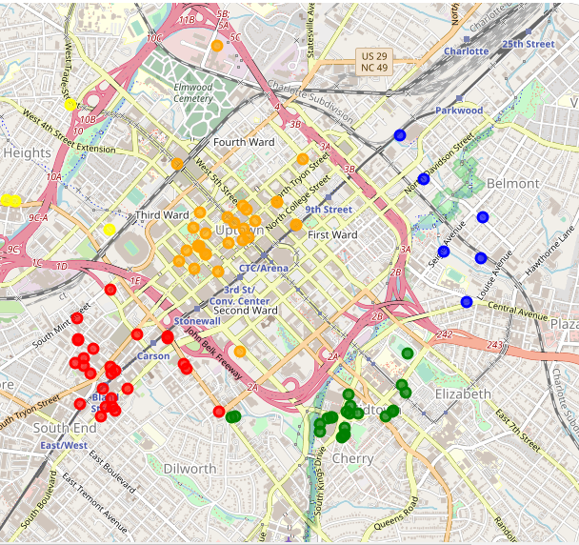
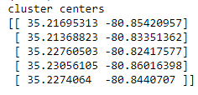
Clustering our venues

Slide 6
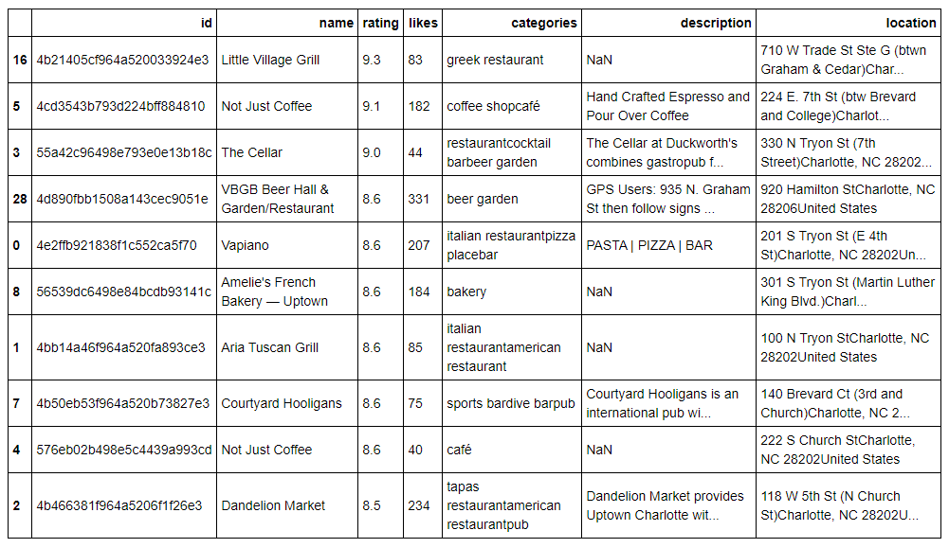
Retrieving Venue Details
'https://api.foursquare.com/v2/venues/{}?&client_id={}&client_secret={}&v={}'

Slide 7
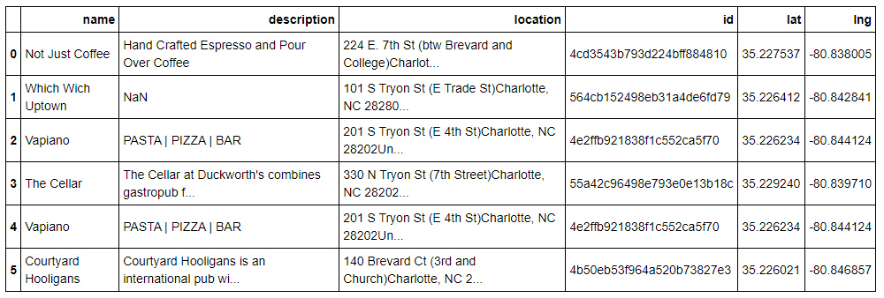
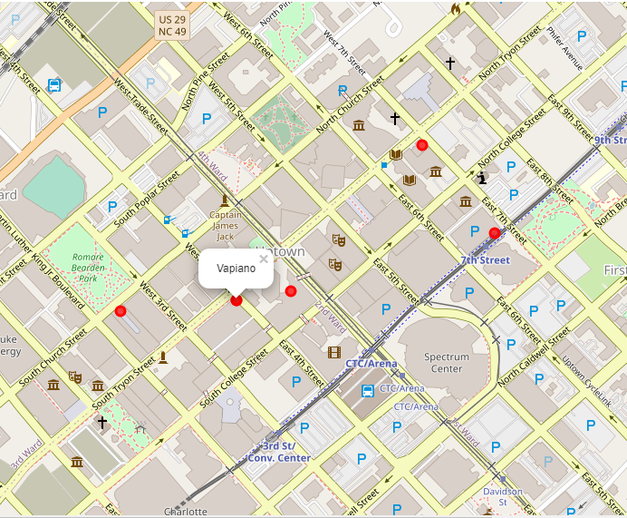
Selecting our top venues

Slide 8
Conclusion
Not Just Coffee
Which Wich Uptown
Vapiano’s Italian Restaurant
Courtyard Hooligans International Pub

